Slide 1

Full stack diploma
JavaScript

Slide 2


http://frontend.projects-amit-learning.com/
Try to open this link on your phone and tap on menu icon then close it.
Are you wondering how this is happing?
We got the answer for you. It is the power of JavaScript and in this material we are going to talk about :
what is JavaScript? ,
what does it offer to us? and
how to deal with it?
V 1.0

Slide 3
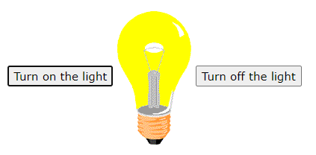
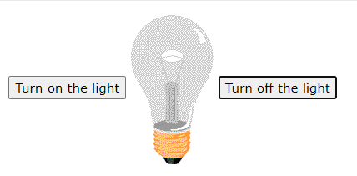
What is JavaScript?
JavaScript is the world's most popular programming language.
Also it’s the programming language of the Web.
JavaScript helps you to program the behavior of web pages.
V 1.0

Slide 4



Where to write JavaScript?
There are 4 places to write JavaScript:
1- In <head> tag 2- In <body> tag
3- We can write JavaScript as an external file (.js) and it’s better to write script in a separated file.
File.js
<body>
<head>
V 1.0

Slide 5
JavaScript Variables
There are three ways to declare variables in JavaScript:
Var
Const
Let
In general, Variables are containers for storing data (values), we will discuss the above three ways in details.
V 1.0

Slide 6
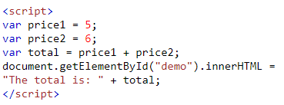

JavaScript Variables
Var
We can use various data types:
1- Athematic operates: + , - , * , / , %.
2- Strings
3- Numbers etc…
V 1.0

Slide 7
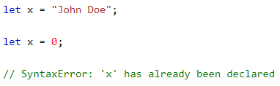
JavaScript Variables
Let
Variables defined with let cannot be Re-declared.
Variables defined with let must be Declared before use.
Variables defined with let have Block Scope.
Lets see what does it mean:
1- Variables defined with let cannot be Re-declared:
V 1.0

Slide 8

JavaScript Variables
Let
Variables defined with let have Block Scope.
Before ES6 (2015), JavaScript had only Global Scope and Function Scope.
ES6 introduced two important new JavaScript keyword blocks: let and const.
These two keywords provide Block Scope in JavaScript.
Variables declared inside a { } block cannot be accessed from outside the.
V 1.0

Slide 9
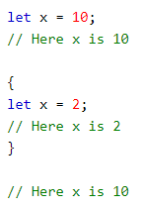
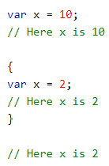
JavaScript Variables
Let
Re-declaring Variables:
Re-declaring a variable inside a block will not re-declare the variable outside the block.
Unlike var Re-declaring a variable inside a block will also re-declare the variable outside the block:
V 1.0

Slide 10
JavaScript Variables
Const
Variables defined with const cannot be Re-declared.
Variables defined with const cannot be Reassigned.
Variables defined with const have Block Scope.
Lets see what does it mean:
V 1.0

Slide 11
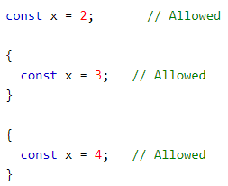
JavaScript Variables
Const
1- Variables defined with const cannot be Re-declared.
Re-declaring a variable with const, in another scope, or in another block, is allowed:
V 1.0

Slide 12
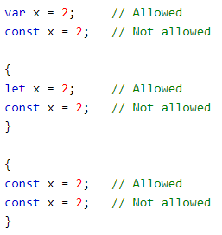
JavaScript Variables
Const
1- Variables defined with const cannot be Re-declared.
Re-declaring an existing var or let variable to const, in the same scope, is not allowed:
V 1.0

Slide 13

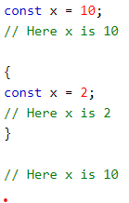
JavaScript Variables
Const
Variables defined with const cannot be Reassigned. Variables defined with const have Block Scope.
Declaring a variable with const is similar to let
when it comes to Block Scope.
V 1.0

Slide 14

JavaScript Datatypes
Numbers
JavaScript has only one type of numbers.
Numbers can be written with, or without decimals:
V 1.0

Slide 15
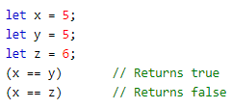
Booleans can only have two values: true or false:
JavaScript Datatypes
Boolean
Booleans can only have two values: true or false:
V 1.0

Slide 16

Booleans can only have two values: true or false:
JavaScript Datatypes
Arrays
JavaScript arrays are written with square brackets.
Array items are separated by commas.
Array indexes are zero-based, which means the first item is [0], second is [1], and so on.
V 1.0

Slide 17
Booleans can only have two values: true or false:
JavaScript Datatypes
Objects
JavaScript objects are written with curly braces {}.
Object properties are written as name:value pairs, separated by commas.
The object (person) in the example above has 4 properties: firstName, lastName, age, and eyeColor.
V 1.0

Slide 18


Booleans can only have two values: true or false:
JavaScript Datatypes
Typeof
You can use the JavaScript typeof operator to find the type of a JavaScript variable.
V 1.0

Slide 19
Booleans can only have two values: true or false:
JavaScript Datatypes
Comments
JavaScript comments can be used to explain JavaScript code, and to make it more readable.
JavaScript comments can also be used to prevent execution, when testing alternative code.
Single Line Comments
Single line comments start with //.
Any text between // and the end of the line will be ignored by JavaScript (will not be executed).
V 1.0

Slide 20


Booleans can only have two values: true or false:
JavaScript Datatypes
Comments
Example:
V 1.0

Slide 21
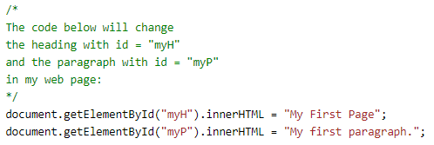
Booleans can only have two values: true or false:
JavaScript Datatypes
Comments
Multi-line Comments
Multi-line comments start with /* and end with */.
Any text between /* and */ will be ignored by JavaScript.
V 1.0

Slide 22
Booleans can only have two values: true or false:
JavaScript Arithmetic Operators
Operator | Description
+ | Addition (1+1 = 2)
- | Subtraction (4-2 = 2)
* | Multiplication (2*2 = 4)
/ | Division (25/5 = 5)
% | Reminder (12 % 5 = 2)
++ | Increment (1++ = 2)
-- | Decrement (4-- = 3)
V 1.0

Slide 23
Booleans can only have two values: true or false:
JavaScript Comparison Operators
Operator (x=5) | Description + Result
== (equal to) | X == 8 -> false
=== (equal value and equal type) | X === 5 -> true
!= (not equal) | X != 8 -> true
!== (not equal value or not equal type) | X !== 5 -> false
> (greater than) | X > 8 -> false
< (less than) | X < 8 -> true
>= (greater than or equal) | X >= 5 -> true
<= (less than or equal) | X <= 8 -> true
V 1.0

Slide 24
Booleans can only have two values: true or false:
JavaScript Logical Operators
Operator (x=6 and y=3) | Description + Result
&& (and) | (x < 10 && y > 1) is true
|| (or) | (x == 5 || y == 5) is false
! (not) | !(x == y) is true
V 1.0

Slide 25

Booleans can only have two values: true or false:
If…else Statement
The if/else statement executes a block of code if a specified condition is true. If the condition is false, another block of code can be executed.
The if/else statement is a part of JavaScript's "Conditional" Statements, which are used to perform different actions based on different conditions.
In JavaScript we have the following conditional statements:
Use if to specify a block of code to be executed, if a specified condition is true
Use else to specify a block of code to be executed, if the same condition is false
Use else if to specify a new condition to test, if the first condition is false
Use switch to select one of many blocks of code to be executed
V 1.0

Slide 26
Booleans can only have two values: true or false:
If…else Statement
Syntax
The if statement specifies a block of code to be executed if a condition is true:
if (condition) { // block of code to be executed if the condition is true }
Example:
if( hour < 10) {
greeting = “Good morning”;
}
V 1.0

Slide 27
Booleans can only have two values: true or false:
If…else Statement
Syntax
The else statement specifies a block of code to be executed if the condition is false:
if (condition) { // block of code to be executed if the condition is true } else { // block of code to be executed if the condition is false }
Example:
if( hour < 10) {
greeting = “Good morning”;
}
else (time < 20) {
Greeting = ‘’Good day”;
}
V 1.0

Slide 28
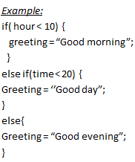
Booleans can only have two values: true or false:
If…else Statement
Syntax
The else if statement specifies a new condition if the first condition is false:
if (condition1) { // block of code to be executed if condition1 is true } else if (condition2) { // block of code to be executed if the condition1 is false and condition2 is true } else { // block of code to be executed if the condition1 is false and condition2 is false }
V 1.0

Slide 29
Booleans can only have two values: true or false:
Switch
The switch statement executes a block of code depending on different cases.
The switch statement evaluates an expression. The value of the expression is then compared with the values of each case in the structure. If there is a match, the associated block of code is executed.
The switch statement is often used together with a break or a default keyword (or both). These are both optional:
The break keyword breaks out of the switch block. This will stop the execution of more execution of code and/or case testing inside the block. If break is omitted, the next code block in the switch statement is executed.
The default keyword specifies some code to run if there is no case match. There can only be one default keyword in a switch. Although this is optional, it is recommended that you use it, as it takes care of unexpected cases.
V 1.0

Slide 30
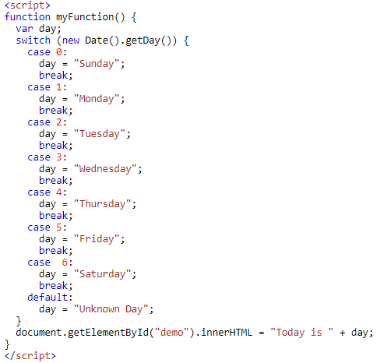


Booleans can only have two values: true or false:
Switch
Try this code today to know which day is today?
V 1.0

Slide 31
Booleans can only have two values: true or false:
Loops
Loops are handy, if you want to run the same code over and over again, each time with a different value.
Different Kinds of Loops:
JavaScript supports different kinds of loops:
for: loops through a block of code a number of times
for/in - loops through the properties of an object
for/of - loops through the values of an iterable object
while: loops through a block of code while a specified condition is true
do/while: also loops through a block of code while a specified condition is true
V 1.0

Slide 32
Booleans can only have two values: true or false:
For Loop
The for loop has the following syntax:
for (statement 1; statement 2; statement 3) { // code block to be executed }
Statement 1 is executed (one time) before the execution of the code block.
Statement 2 defines the condition for executing the code block.
Statement 3 is executed (every time) after the code block has been executed
V 1.0

Slide 33

Booleans can only have two values: true or false:
For Loop
Example:
for (let i = 0; i < 5; i++) { text += "The number is " + i + "<br>"; }
Statement 1 sets a variable before the loop starts (let i = 0).
Statement 2 defines the condition for the loop to run (i must be less than 5).
Statement 3 increases a value (i++) each time the code block in the loop has been executed.
V 1.0

Slide 34
Booleans can only have two values: true or false:
For/in Loop
The JavaScript for in statement loops through the properties of an Object:
Syntax:
for (key in object) { // code block to be executed }
V 1.0

Slide 35


Booleans can only have two values: true or false:
For/in Loop
Example:
V 1.0

Slide 36
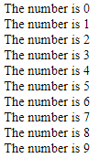
Booleans can only have two values: true or false:
While Loop
The while loop loops through a block of code as long as a specified condition is true.
while (condition) { // code block to be executed }
Example:
while (i < 10) { text += "The number is " + i; i++; }
V 1.0

Slide 37
Booleans can only have two values: true or false:
For/of Loop
The JavaScript for of statement loops through the values of an iterable object.
It lets you loop over iterable data structures such as Arrays, Strings, Maps, NodeLists, and more
Syntax:
for (variable of iterable) { // code block to be executed }
variable - For every iteration the value of the next property is assigned to the variable. Variable can be declared with const, let, or var.
iterable - An object that has iterable properties.
V 1.0

Slide 38


Booleans can only have two values: true or false:
For/of Loop
Example:
V 1.0

Slide 39

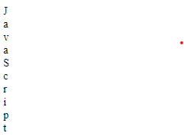
Booleans can only have two values: true or false:
For/of Loop
Example:
V 1.0

Slide 40
Booleans can only have two values: true or false:
Do…While Loop
The do while loop is a variant of the while loop. This loop will execute the code block once, before checking if the condition is true, then it will repeat the loop as long as the condition is true.
do { // code block to be executed } while (condition);
V 1.0

Slide 41
Booleans can only have two values: true or false:
Function
A JavaScript function is a block of code designed to perform a particular task.
A JavaScript function is executed when "something" invokes it (calls it).
Syntax:
function myFunction(p1, p2) { return p1 * p2;
// The function returns the product of p1 and p2 }
V 1.0

Slide 42
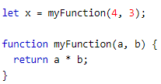
Booleans can only have two values: true or false:
Function
Example:
The result is: 12
V 1.0

Slide 43
Booleans can only have two values: true or false:
Array
What is an Array?
An array is a special variable, which can hold more than one value at a time.
Syntax:
const array_name = [item1, item2, ...];
Example:
const fullstack = [“HTML", “JS", “PHP"];
V 1.0

Slide 44

Booleans can only have two values: true or false:
DOM
When a web page is loaded, the browser creates a Document Object Model of the page.
The HTML DOM model is constructed as a tree of Objects:
V 1.0

Slide 45
Booleans can only have two values: true or false:
DOM
What is the HTML DOM?
The HTML DOM is a standard object model and programming interface for HTML. It defines:
The HTML elements as objects
HTML DOM methods are actions you can perform (on HTML Elements).
HTML DOM properties are values (of HTML Elements) that you can set or change.
The events for all HTML elements
The HTML DOM is a standard for how to get, change, add, or delete HTML elements.
V 1.0

Slide 46

Booleans can only have two values: true or false:
DOM Methods
HTML DOM methods are actions you can perform (on HTML Elements like add or deleting an HTML elements).
V 1.0

Slide 47
Booleans can only have two values: true or false:
DOM Methods
The getElementById Method:
The most common way to access an HTML element is to use the id of the element.
The innerHTML Property:
The easiest way to get the content of an element is by using the innerHTML property.
The innerHTML property is useful for getting or replacing the content of HTML elements.
V 1.0

Slide 48
Booleans can only have two values: true or false:
DOM Methods
Method | Description
document.getElementById(id) | Find an element by element id
document.getElementsByTagName(name) | Find elements by tag name
document.getElementsByClassName(name) | Find elements by class name
document.querySelectorAll() | If you want to find all HTML elements that match a specified CSS selector (id, class names, types, attributes, values of attributes, etc)
V 1.0

Slide 49
Booleans can only have two values: true or false:
DOM Methods
Differences between querySelector() and querySelectorAll():
querySelector() method can only be used to access a single element while querySelectorAll() method can be used to access all elements which match with a specified CSS selector. To return all matches, querySelectorAll has to be used, while to return a single match, querySelector is used
V 1.0

Slide 50
Booleans can only have two values: true or false:
DOM Properties
Property | Description
element.innerHTML = new html content | Change the inner HTML of an element
element.attribute = new value | Change the attribute value of an HTML element
element.style.property = new style | Change the style of an HTML element
V 1.0

Slide 51
Booleans can only have two values: true or false:
BOM
There are no official standards for the Browser Object Model (BOM).
Since modern browsers have implemented (almost) the same methods and properties for JavaScript interactivity, it is often referred to, as methods and properties of the BOM.
The Window Object:
All global JavaScript objects, functions, and variables automatically become members of the window object.
Global variables are properties of the window object.
Global functions are methods of the window object.
window.document.getElementById("header");
is equal to
document.getElementById("header");
V 1.0

Slide 52
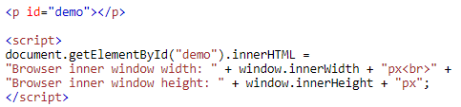

Booleans can only have two values: true or false:
BOM
Window Size
Two properties can be used to determine the size of the browser window.
Both properties return the sizes in pixels:
window.innerHeight - the inner height of the browser window (in pixels)
window.innerWidth - the inner width of the browser window (in pixels)
V 1.0

Slide 53
Booleans can only have two values: true or false:
BOM
Window History
The window.history object can be written without the window prefix.
To protect the privacy of the users, there are limitations to how JavaScript can access this object.
Some methods:
history.back() - same as clicking back in the browser. loads the previous URL in the history list
history.forward() - same as clicking forward in the browser .The history.forward() method loads the next URL in the history list.
V 1.0

Slide 54

Booleans can only have two values: true or false:
BOM
Window Location Href
The window.location.href property returns the URL of the current page.
V 1.0

Slide 55


Booleans can only have two values: true or false:
BOM
Window Location Hostname
The window.location.hostname property returns the name of the internet host (of the current page)
V 1.0

Slide 56


Booleans can only have two values: true or false:
BOM
Window Location Pathname
The window.location.pathname property returns the pathname of the current page.
V 1.0

Slide 57


Booleans can only have two values: true or false:
Events
A JavaScript can be executed when an event occurs, like when a user clicks on an HTML element.
V 1.0

Slide 58
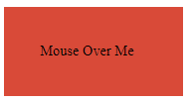
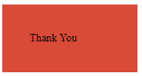

Booleans can only have two values: true or false:
Events
The mouseover and mouseout Events
The onmouseover and onmouseout events can be used to trigger a function when the user mouses over, or out of, an HTML element:
V 1.0

Slide 59
Booleans can only have two values: true or false:
Events
The onmousedown , onmouseup and onclick Events?
The onmousedown, onmouseup, and onclick events are all parts of a mouse-click. First when a mouse-button is clicked, the onmousedown event is triggered, then, when the mouse-button is released, the onmouseup event is triggered, finally, when the mouse-click is completed, the onclick event is triggered
V 1.0

Slide 60
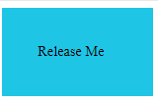
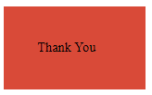
Booleans can only have two values: true or false:
Events
V 1.0

Slide 61
Booleans can only have two values: true or false:
Events
AddEventListener()
The addEventListener() method attaches an event handler to the specified element.
When using the addEventListener() method, the JavaScript is separated from the HTML markup, for better readability and allows you to add event listeners even when you do not control the HTML markup.
You can easily remove an event listener by using the removeEventListener() method.
V 1.0

Slide 62
Booleans can only have two values: true or false:
Events
AddEventListener()
Sytnax:
element.addEventListener(event, function, useCapture);
The first parameter is the type of the event (like "click" or "mousedown" or any other HTML DOM Event.)
The second parameter is the function we want to call when the event occurs.
The third parameter is a boolean value specifying whether to use event bubbling or event capturing. This parameter is optional.
V 1.0

Slide 63
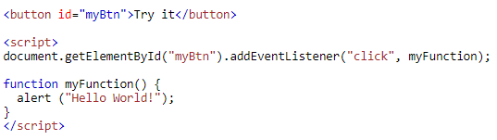
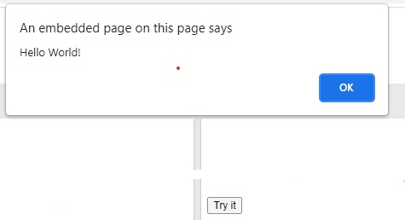
Booleans can only have two values: true or false:
Events
AddEventListener()
Example:
V 1.0

Slide 64
Booleans can only have two values: true or false:
JavaScript ES6
ECMAScript 2015 was the second major revision to JavaScript.
ECMAScript 2015 is also known as ES6 and ECMAScript 6.
V 1.0

Slide 65

Booleans can only have two values: true or false:
JavaScript ES6
Arrow Functions
Arrow functions allows a short syntax for writing function expressions.
You don't need the function keyword, the return keyword, and the curly brackets.
Arrow functions are not hoisted.
They must be defined before they are used.
Using const is safer than using var,
because a function expression is always a
constant value.
V 1.0

Slide 66

Booleans can only have two values: true or false:
JavaScript ES6
Arrow Functions
You can only omit the return keyword and the curly brackets if the function is a single statement. Because of this, it might be a good habit to always keep them in this way:
255
V 1.0

Slide 67
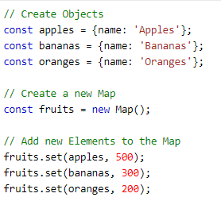
Booleans can only have two values: true or false:
JavaScript ES6
Map Objects
Map is a collection of elements where each element is stored as a Key, value pair.
V 1.0

Slide 68
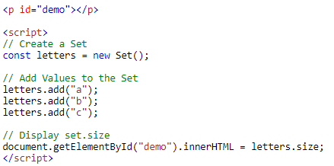
Booleans can only have two values: true or false:
JavaScript ES6
Set Objects
Set objects are collections of values. You can iterate through the elements of a set in insertion order.
3
V 1.0

Slide 69

Booleans can only have two values: true or false:
JavaScript ES6
Classes
Use the keyword class to create a class.
Always add a method named constructor()
Syntax:
V 1.0

Slide 70
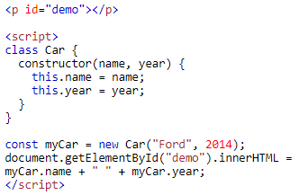
Booleans can only have two values: true or false:
JavaScript ES6
Classes
Example:
Ford 2014
V 1.0

Slide 71
Booleans can only have two values: true or false:
JavaScript ES6
Promises
A Promise is a JavaScript object that links "Producing Code" and "Consuming Code".
"Producing Code" can take some time and "Consuming Code" must wait for the result.
V 1.0

Slide 72
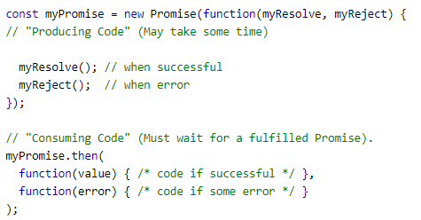
Booleans can only have two values: true or false:
JavaScript ES6
Promises
Syntax:
V 1.0

Slide 73
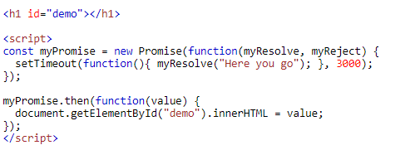

Booleans can only have two values: true or false:
JavaScript ES6
Promises
Example:
V 1.0

Slide 74
Booleans can only have two values: true or false:
JavaScript ES6
The Symbol Type
A JavaScript Symbol is a primitive datatype just like Number, String, or Boolean.
It represents a unique "hidden" identifier that no other code can accidentally access.
Symbols are always unique.
If you create two symbols with the same description they will have different values.
V 1.0

Slide 75
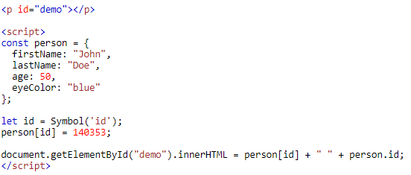
Booleans can only have two values: true or false:
JavaScript ES6
The Symbol Type
Example:
140353 undefined
V 1.0

Slide 76
Booleans can only have two values: true or false:
JavaScript ES6
New Math Methods
Math.trunc()
Math.sign()
Math.cbrt()
Math.log2()
Math.log10()
V 1.0

Slide 77
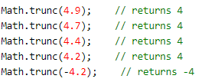
Booleans can only have two values: true or false:
JavaScript ES6
New Math Methods
Math.trunc()
returns the integer part of x:
V 1.0

Slide 78

Booleans can only have two values: true or false:
JavaScript ES6
New Math Methods
Math.sign()
returns if x is negative, null or positive:
V 1.0

Slide 79

Booleans can only have two values: true or false:
JavaScript ES6
New Math Methods
Math.cbrt()
returns the cube root of x:
V 1.0

Slide 80

Booleans can only have two values: true or false:
JavaScript ES6
New Math Methods
Math.log2()
returns the base 2 logarithm of x:
V 1.0

Slide 81

Booleans can only have two values: true or false:
JavaScript ES6
New Math Methods
Math.log10()
returns the base 10 logarithm of x:
V 1.0

Slide 82

Booleans can only have two values: true or false:
JavaScript ES6
New Number Properties
EPSILON
V 1.0

Slide 83
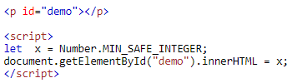
Booleans can only have two values: true or false:
JavaScript ES6
New Number Properties
MIN_SAFE_INTEGER
V 1.0

Slide 84

Booleans can only have two values: true or false:
JavaScript ES6
New Number Properties
MAX_SAFE_INTEGER
V 1.0

Slide 85
Booleans can only have two values: true or false:
JavaScript ES6
New Number Properties
Number.isInteger()
Number.isSafeInteger()
V 1.0

Slide 86

Booleans can only have two values: true or false:
JavaScript ES6
New Number Properties
Number.isInteger()
method returns true if the argument is an integer.
V 1.0

Slide 87

Booleans can only have two values: true or false:
JavaScript ES6
New Number Properties
Number.isSafeInteger()
method returns true if the argument is a safe integer.
V 1.0

Slide 88

Booleans can only have two values: true or false:
JavaScript ES6
New Number Properties
The isFinite() Method
The global isFinite() method returns false if the argument is Infinity or NaN.
Otherwise it returns true:
V 1.0

Slide 89

Booleans can only have two values: true or false:
JavaScript ES6
New Number Properties
The isNaN() Method
The global isNaN() method returns true if the argument is NaN. Otherwise it returns false:
V 1.0

Slide 90
Thank You!

